Slide 1
Advisor Meeting
March 8th

Slide 2
Week 5 Tasks
Story
banking(opening accounts)
Credit system
loan
Prototype
Bodega(tweaking)
Stock Market(index funds, virtual coins)

Slide 3
Agenda
Storyboard
Prototype

Slide 4
Storyboard
Take over Bodega
Saving/Checking account
Credit cards -- Credit system
Loan

Slide 5
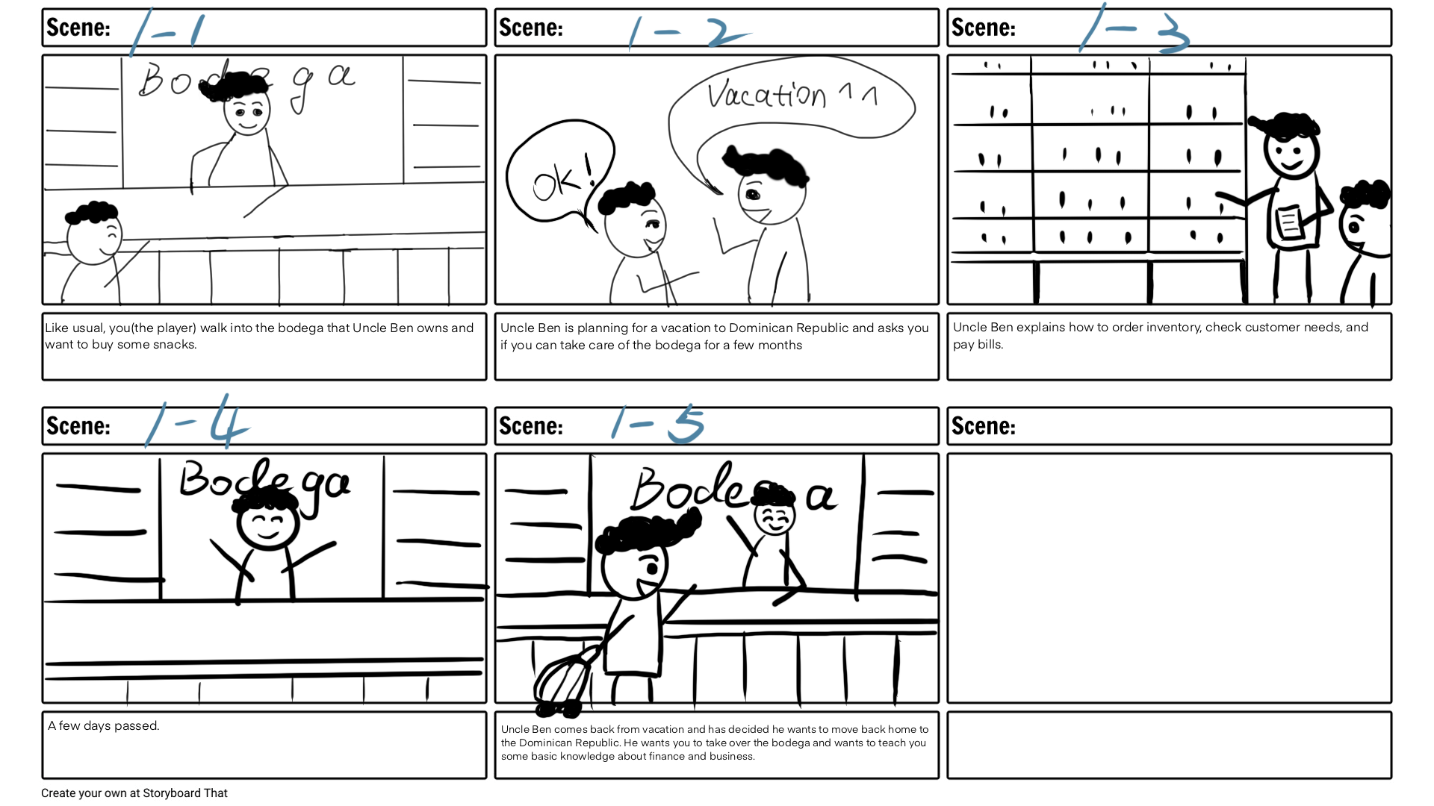
Storyboard

Slide 6
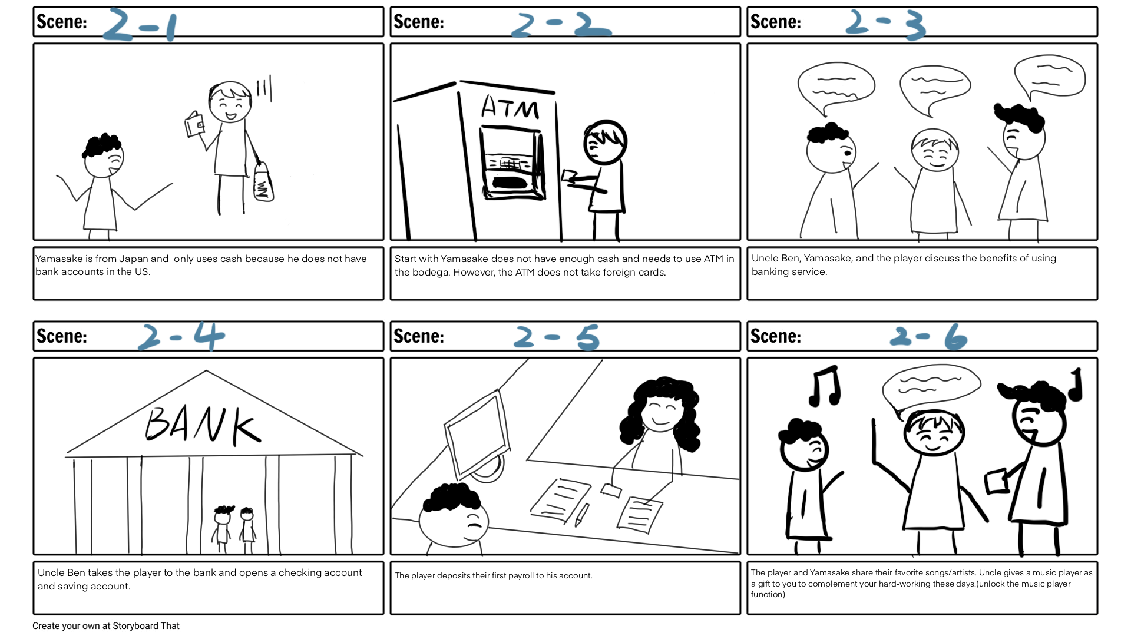

Slide 7
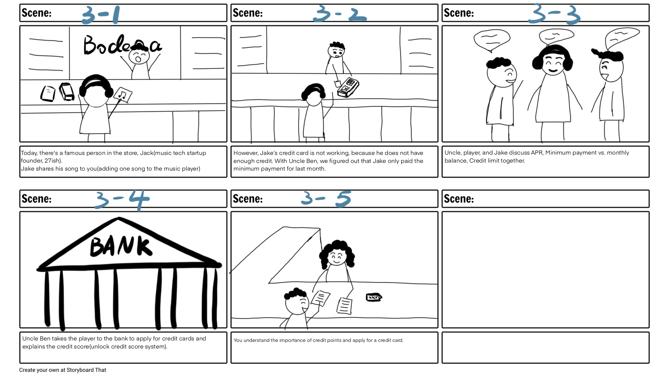

Slide 8
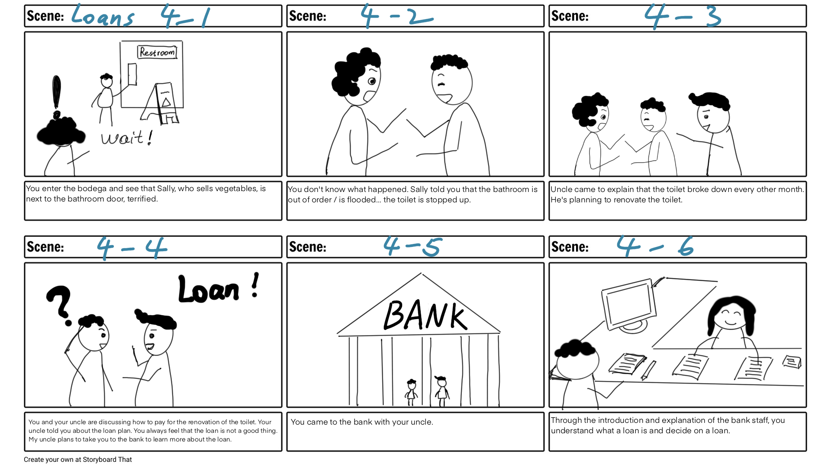

Slide 9
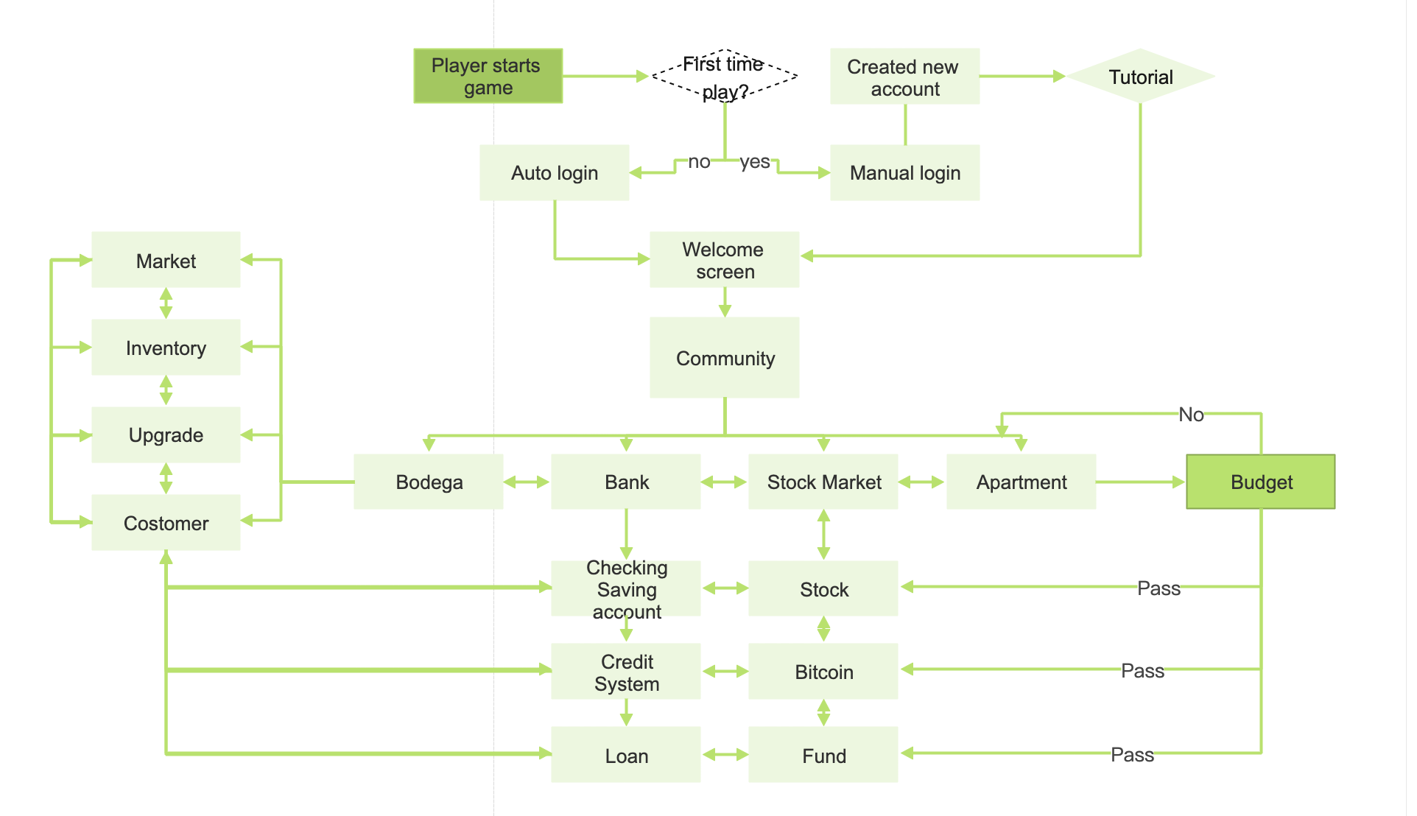

Slide 10
Prototype

